Slide 1
IEEE 802.15.4 Revision Status Report for IETF 91
IETF 6TiSCH 6top IEEE 802.15.4 TSCH

Slide 2
Summary of changes to IEEE Std. 802.15.4 revision (12 Nov 2014)
Latest draft is D2 (not publically available)
Revision consists of
802.15.4-2011 as the baseline
roll up of amendments: 4e, 4f, 4g, 4j, 4k, 4m, 4p
approved changes from 802.15 maintenance standing committee
Corrigenda and editorial changes
Still in work group letter ballot - recirculation
IEEE-SA approval target – 802.15.4-2015 (Aug 2015)

Slide 3
Editorial Changes
Size reduction: even though D2 is 661 pages, it’s consists of 15.4-2011 and 7 amendments which added up to 1324 pages.
Scrubbing definitions, acronyms, and bibliography for terms/references that are not used
Added Clause 4 Format conventions
Contents of this clause is focused upon global document issues such as bit ordering and such nomenclature for the MAC and all PHYs
Increases all normative clause numbers
Eliminating duplicative definitions, normative declarations, and behavior descriptions (e.g. state once and refer multiple times)

Slide 4
ID Management Process
IEEE 802.15 WG Assigned Numbers Authority
The objective of the Assigned Numbers Authority (ANA) is to conserve and allocate identifier values in the IEEE 802.15 standards and approved amendments.
A limited number of numbers may be assigned to allow non-IEEE 802 standards development organizations (SDO) to extend the use of IEEE 802.15.4
Only the following categories of IDs may be assigned for IEEE Std. 802.15.4:
Frame Extension ID
Header Information Element (IE) Element ID
Payload IE Group ID
Only one number shall be assigned to a non-IEEE 802 SDO from an ID category. The non-IEEE 802 SDO is responsible to create a method for sub-typing that would prevent the need for an additional ID.

Slide 5
Frame ID Extension
000 Beacon
001 Data
010 Acknowledgment
011 MAC command
100 Reserved
101 Multipurpose
110 Fragment or Frak1 (use limited to LECIM DSSS PHY)
111 Extended (indicates next 3 bits are frame extensions
000-011 Reserved
111 Assigned to Telecommunications Industry Association (TIA)

Slide 6
Information Element IDs (Note: ID #s have changed from 15.4e)
Header IE IDs:
0x00 Vendor Specific (1st 3 bytes are vendor’s OUI)
0x01–0x18, 0x1f-0x20, 0x2a-0x7d reserved
0x7e Header Termination 1 IE
0x7f Header Termination 2 IE
0x80–0xff reserved
Payload IE IDs:
0x0 Encapsulated Service Data Unit (ESDU)
0x1 MLME (Nested, sub-IDs have assignments)
0x2 Vendor Specific
0x3–0xe Reserved
0xf Payload termination

Slide 7
Extinct Terms attributes, constants, PIBs that are gone
phyCCATimeMethod
macMinLIFSPeriod
macMinSIFSPeriod
macEnhAckWaitDuration
macMaxFrameTotalWaitTime
macTxControlActiveDuration
macTxControlPauseDuration

Slide 8
Endangered Terms attributes, constants, PIBs that are on their way out
phyPHRDuration (not used)
phyCCADuration (used only for 920 MHz band)
aMaxMACSafePayloadSize (not a constant)
aMaxMPDUUnsecuredOverhead (not a constant)
aMinMPDUOverhead (not a constant)
macTxTotalDuration (PIB is defined but not used)

Slide 9
InterFrame Spacing (IFS)
Previously:
Short IFS (SIFS) and Long IFS (LIFS)
Now: SIFS, LIFS, and Ack IFS (AIFS)
LIFS = macLIFSPeriod = 40 symbols (except RCC)
SIFS = macSIFSPeriod = 12 symbols (except RCC)
AIFS =
1 ms for the SUN PHYs, LECIM PHYs or TVWS PHYs
macSIFSPeriod for all other PHYs.

Slide 10
Changes within TSCH
Terminology
Change to harmonize terms in TSCH with rest of standard, e.g. definition of macTsTxOffset should refer to the PPDU rather than the frame which is the MAC portion of the PPDU.
Default Values (ID=0, Table 137)
macTsRxOffset –changed from 1120 µs to 1116 µs to align center of macTsRxWait with macTsTxOffset
Added 915 MHz SUN defaults (also ID=0)
Numbers based upon 100 kb/s, 1522 byte payload, 1 ms Transmit to Receive turnaround

Slide 11
CSMA-CA Flow Charts and Scope
CSMA-CA flow chart has been merged with TSCH CSMA-CA flow chart
New flow chart being drawn to show initiation of transmission for all modes, beginning at:
MCPS-DATA.request
MLME-BEACON.request
MLME-POLL.request
and concluding at the CSMA-CA flow chart or regulatory procedure or PHY transmission
Includes test for valid frame size

Slide 12
CSMA-CA Flow Charts and Scope (cont’d)
CSMA-CA and CCA are now focused only upon peaceful coexistence with other 802.15.4 devices and networks.
Regulatory compliance such as listen-before-talk along with coexistence with non-802.15.4 protocols is out of scope. But can be done with 802.15.4 elements such as CCA modes 1 – 6
New ETSI requirements stretched CCA operation too far, moving regulatory behavior out of standard allows us to maintain original function of CCA
Text added to end of 10.2.7 CCA modes
NOTE—These modes are used to provide cooperative utilization of the medium in an IEEE 802.15.4 network. They are not designed to provide regulatory compliance, and in some cases only a subset of these modes may meet regulatory requirements.
As an example, EN 300 328 v 1.8.1 and above require energy detect for a minimum of 20 μs. In this case an implementer could choose to use CCA mode 2 within the CSMA-CA algorithm, followed by a 20 μs ED in accordance to the requirements of the ETSI standard in order to achieve regulatory compliance. Implementing a design in this manner would provide an optimized network that would not be disadvantaged in a mixed protocol environment with networks other than IEEE 802.15.4.

Slide 13
TSCH CSMA-CA harmonization with Priority Channel Access (PCA)
PCA provides mechanism to give priority frames faster access to the medium within shared time-slots compared to lower priority frames
Priority is assigned by a layer above the MAC
PCA is complementary to 6top’s priority queue mechanism
Effort underway to modify flow charts such that PCA fits within constraints of TSCH

Slide 14
When is what used and how?
Significant effort is underway to remove ambiguity as to when and how to use added behaviors such as:
Imm-Ack vs. Enh-Ack
Data frame vs. Multipurpose frame
Beacon vs. Enhanced Beacon
Low Energy: CSL vs. RIT vs. I-RIT vs. TVWSPS
Association vs. FastAssociation vs. do nothing
DSME vs. GTS

Slide 15
Corrections to IEEE Std. 802.15.4 Security Third time is the charm?
Note: it is so much easier to do it wrong than to do it right

Slide 16
Security Changes
State machines
People found the text confusing
Allowing frame counters to be per key, not per device
TG9 KMP wanted this
Specified how security is done on new frame types
i.e. which parts are encrypted and which are not
Removed security level 4 (encrypt only)
Special for TSCH
Frame counter vs ASN
Removed the 5-octet frame counter format from frame (frame counter field in header).

Slide 17
State Machines
Inbound and outbound state machines are skipping some states that are not needed when using TSCH (all frame counter related things, as TSCH is using ASN)
Trying to make it clear that security level 0 (no security) and other security level packets can be mixed
This was true before, but it was very hard to see before the state machine figures.
Cleaning them up
State Machine figures are shown on next slide

Slide 18
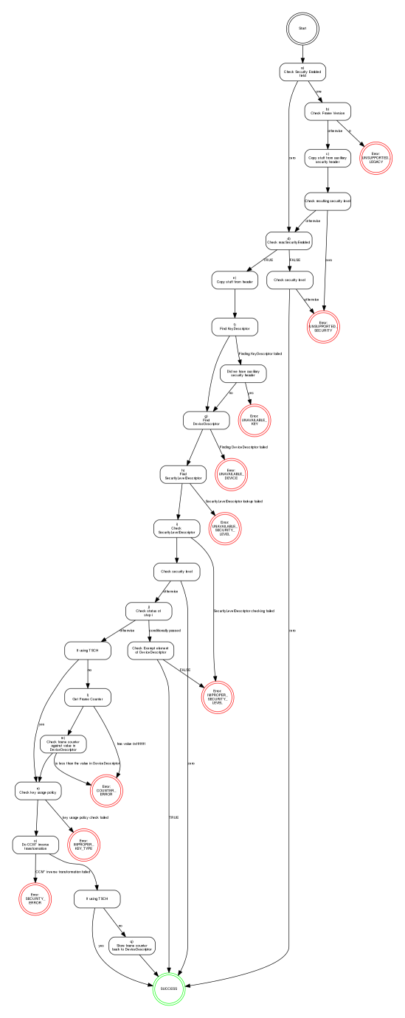
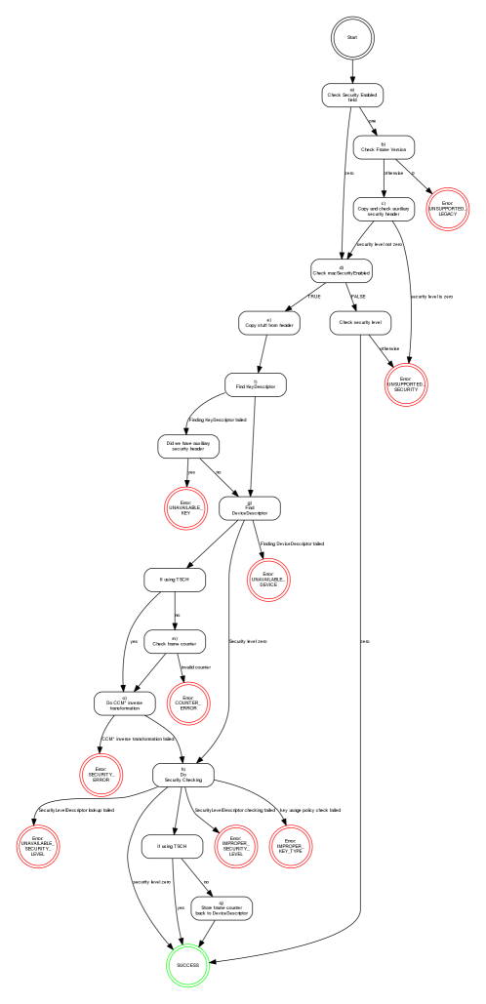
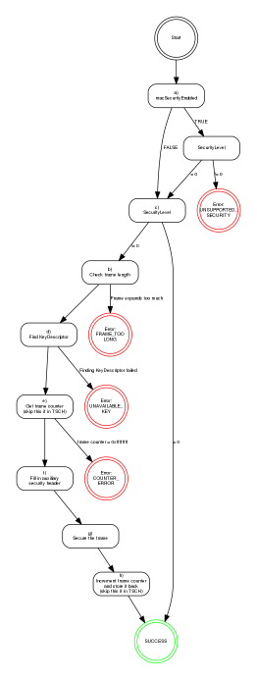
State Machine Figures
Original inbound
Modified inbound (work in progress)
Original outbound

Slide 19
Other Changes
Added section to describe nonce generation for TSCH
Always use 5-octet ASN (absolute slot number)
Do not allow short addresses in the address field
There was 5-octet frame counter option in the security header, but as 5-octet nonce generation is now used only in TSCH, and that always uses ASN, removed the whole 5-octet frame counter field.
Specified that frame counter suppression can only be used when using ASN or similar (i.e. not copy the frame counter from inbound frame for Enh-Acks)

Slide 20
Protocol Implementation Conformance Statement (PICS)
Annex D: statement of which capabilities and options of the protocol have been implemented
Protocol classifications are:
M - Mandatory
O - Optional
O.n - Optional, but support of at least one of the group of options labeled O.n is required.
X - Prohibited
Conditional – status is dependent upon the inclusion of other optional protocol
Unfortunately, this annex is hopelessly dysfunctional, and must be extensively rewritten

Slide 21
Updated Revision Schedule
Letter Ballot (LB)
Start 14 June 2014
End 13 July 2014 (San Diego)
LB Recirculations
Start 20 Oct 2014
End 12 Jan 2015 (Atlanta)
Sponsor Ballot (SB)
Start Mar, 2015 (Berlin)
Ends May, 2015
SB Recirculations
Start Jun, 2015
End Jul, 2015
EC submittal 17 July, 2015 (Hawaii)
RevCom 27 August 2015

Slide 22
Background information
Overview of IEEE standards process
Notes:
22
22

Slide 23
Principles of the process
Due process – procedures are publicly available and followed consistently
Consensus – requiring agreement of a majority (>50%) for procedural decisions or supermajority (>75%) for technical decisions
Openness – ensuring materially interested and affected parties can participate
Balance – representation from all interested parties without overwhelming influence from any one party
Right of appeal – process to ensure due process
Notes:
23
23

Slide 24
Basic IEEE Acronyms
PAR – Project Authorization Request – the charter for a standards project
CSD – Criteria for Standards
IG – Interest Group – group formed to provide a forum for specific applications or technologies.
SG – Study Group – a group formed to investigate a project and produce a PAR
TG – Task Group – group formed to produce a draft standard, recommended practice, guideline, supplement, or portion of a draft standard
Notes:
24
24

Slide 25
IEEE Project Types
Amendment
Often classified as either MAC or PHY
Adds new material/protocols to existing standard
Document only contains the changes to standard
Example: 802.15.4e-2012 was a MAC amendment
Corrigendum
Limited to error correction of existing standard
Document only contains the changes to standard
Revision
Maintenance revision rolls up all amendments into a single document
Any text in the standard may be changed
Document contains all text of the standard
Example: 802.15.4-2011 was a revision

Slide 26
IEEE 802.15 standards development life cycle – part 1
Interest Group (IG)
formed
NesCom & Standards Board review
Adequate interest?
Standards Board
Project approval
Study Group formed,
Investigates forming
a project by producing a PAR and Criteria for Standards Development (CSD)
Start Task Group (TG) in Working Group
Working Group and
EC review
Start collecting use cases and requirements
If EC approves PAR, forward PAR to NesCom
Notes:
26
26

Slide 27
IEEE 802 CSD
Broad Market Potential
Compatibility
Distinct Identity
Technical Feasibility
Economic Feasibility
Coexistence with other 802 standards
Notes:
27
27

Slide 28
IEEE 802 standards development life cycle – part 2
Review ballot comments, modify draft as needed
Review proposals
Changes or new disapproves?
Material selected?
Recirculate changes and disapprove comments
Create and refine draft
Draft complete?
No changes, no new disapproves, 75% WG approval and WG approves forwarding to sponsor ballot
Working Group (WG) ballot
Notes:
28
28

Slide 29
IEEE 802 standards development life cycle – part 3
Request EC approve
forward to RevCom
Request 802 executive committee (EC) approve forward to sponsor ballot
EC approval
RevCom approval
Sponsor ballot
Standards Board
approval
Review ballot
comments, modify draft as needed
No changes and no new disapproves, 75% approve
Prepare for publication
Changes or new disapproves?
Published standard
Notes:
29
29

Slide 30
Standards life cycle – part 4
And then there is maintaining the standard
Respond to request for interpretation
Keep the standard current by producing amendments and corrigenda (corrections)
Renew the life of the standard with reaffirmation or revision
When the standard is out of date, withdraw it.
Notes:
30
30

Slide 31
Voting and membership
Voters have responsibility to vote on letter ballots
Three levels of voting occur in IEEE 802 standards development:
Sponsor ballot
Open to all interested parties
Via IEEE SA-membership or paying a per ballot fee
Participation requires an IEEE Web Account
Working group
Requirements on next page
Task force or task group
Requirements vary – consult Working group.
Notes:
31
31

Slide 32
Acquiring Working Group
voting membership
Participating at a meeting = at least 75% presence.
For a new Working Group, persons participating in the initial meeting become members.
For an existing Working Group, after attending 2 of last 4 plenary sessions or 1 plenary and 1 interim, membership starts at the next plenary attended.
Notes:
32
32

Slide 33
Retaining Working Group voting membership
Participate in 2 of the last 4 plenary sessions
An interim may substitute for one of the 2 plenary sessions.
Return working Group letter ballots
Membership may be lost for failing to respond or responding abstain for reason other than “lack of technical expertise” to 2 of the last 3 ballots.
Notes:
33
33

Slide 34
BTW: other 802.15.4 efforts underway
TG4n
PHY amendment for China medical band (starting Sponsor Ballot)
TG4q
Ultra low power PHY – long life from a coin cell battery (WG letter ballot - recirculation)
TG4r
Ranging – provide consistent MAC interface, and provide ranging techniques from existing PHYs (hearing use cases and collecting requirements)
TG4s
Spectrum resource utilization management (just started)
Notes:
34
34

Slide 35
BTW: other 802.15 efforts underway that are complementary to 802.15.4
802.15.9
This project will provide a Recommended Practice for the transport of KMP datagrams within 802.15.4. It will also provide guidelines for KMPs like IETF's HIP, IKEv2, IEEE Std 802.1X, and 4-Way-Handshake. Status of this group is that they are in WG letter ballot which ends 11 December 2014
802.15.10
The end work product of TG10, Layer 2 Routing (L2R), is the generation of a recommended practice for routing packets in dynamically changing 802.15.4 wireless networks. Status of this group is that the proposers have merged their proposals into a single document.
Notes:
35
35

Slide 36
IG 6TISCH reflector information
stds-802-15-ig6t@listserv.ieee.org
http://grouper.ieee.org/groups/802/15/pub/Subscribe.html
Next Session: January 11-16, 2015, Hyatt Regency Atlanta, Atlanta, GA

